Slide 1
Beating the bookies
Predicting cricket results from the Indian Premier League

Slide 2
Why cricket? And why the IPL?
Viewership for the 2011 World Cup final was estimated at 558 million (viewership for Super Bowl in 2017 was 111 million)
Cricket betting was valued at $10 billion annually (but some estimates closer to $50 billion)
Indian Premier League is the richest annual tournament, played between April and May
Rupert Murdoch's Star India paid $2.55 billion to buy the five-year global media rights of the Indian Premier league (IPL)
Sources:
https://www.cnbc.com/2017/09/27/indian-premier-league-cricket-a-rich-sport-is-getting-a-lot-richer.html
http://www.espncricinfo.com/pakistan/content/story/535250.html
http://www.espncricinfo.com/story/_/id/19660717/billion-people-watch-champions-trophy-final
http://fortune.com/2017/02/06/super-bowl-111-million-viewers/

Slide 3
T20 cricket in one minute
 | Cricket | Baseball
Number of players | 11 | 9
Number of innings | 1 | 9
Length of innings | 20 overs (120 balls) or until all batsmen are out | Unlimited balls, continues until 3 outs
Bowler / pitcher | 6 balls at a time from one ‘end’ of the pitch | Unlimited, until end of game or substitution
Ways to get out | 10 (5 common, 5 rare) | 18? (but most are rare)*
Runs | 1 - 6 (rare cases more is possible) | 1 - 4
Average runs per team | 155 (IPL average) | 4.17 per team (2013)**
How a game ends | 3 ways | End of 9th innings (if not tied)
Who wins | Team with most runs | Team with most runs
Sources:
* https://www.foxsports.com/mlb/gallery/types-of-baseball-outs-ranked-mlb-flyout-caught-stealing-strike-base-042517
**
https://www.sportingcharts.com/articles/mlb/what-is-the-average-number-of-runs-scored-in-an-mlb-game.aspx

Slide 4
Methodology
Hypothesis
Machine learning models can outperform betting odds in determining the winner of an IPL match
Preparation and processing of data
Descriptive statistics and visualization
Generate models
Logistic Regression
Random Forest Classifier
Extreme Gradient Boosting Classifier (xgboost)
Neural Networks: Multiplayer Perceptron and Sequential model

Slide 5
The data
The bulk of the data used are from a Kaggle dataset by Manas: “Indian Premier League (Cricket)”
Two datasets
Ball-by-ball information for each match (batsman, bowler, teams, outcomes for each ball)
Match-level information (teams, venue, team batting first, umpires, win by stats)
636 matches played between 2008 – 2017, but keep only 557 matches (mainly from dropping 2009 season)
This amounted to 132,806 balls bowled to 443 batsmen and 340 bowlers
13 teams (but max of 9 in a season) playing across 23 cities (so clearly a home team mismatch)
Main activities
Clean up the datasets: common spelling, remove draws and abandoned games, process data into easier formats, drop the 2009 season
Create a home team feature
Aggregate and merge runs and wickets from ball-by-ball dataset into the match dataset
Create squad level statistics: Summarize individual information from ball-by-ball information to generate team-level statistics (e.g. team batting average and batting strike rate; team bowling average, strike rate and economy)

Slide 6
Feature set of 56
Aggregate these stats to form team statistics
Team batting average (top 7 batsmen in the season)
Team batting strike rate (top 7 batsmen)
Team bowling average (all bowlers who delivered more than 72 balls)
Team bowling strike rate (>72 balls)
Team bowling economy (> 72 balls)
The teams statistics are leaky
Season dummies (2008, 2010 – 2017)
Home team dummies (13 including ‘no home team’)
Team dummies (13 for team 1 and 13 for team 2)
Betting odds taken from oddsportal.com (an aggregate measure of odds across various betting sites)

Slide 7
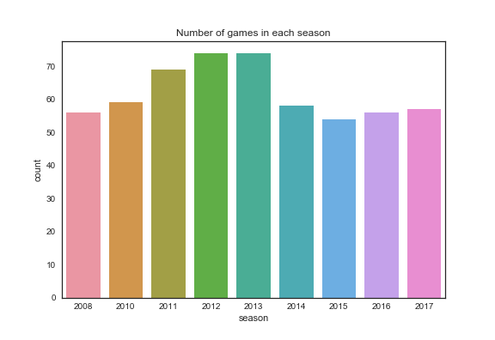

Slide 8
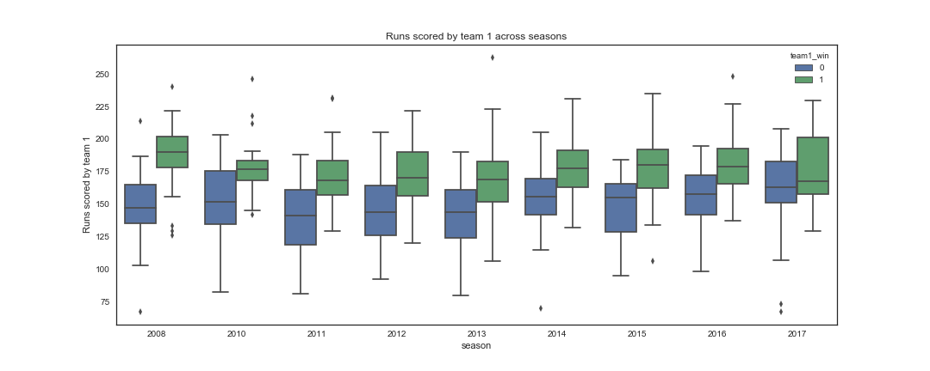

Slide 9
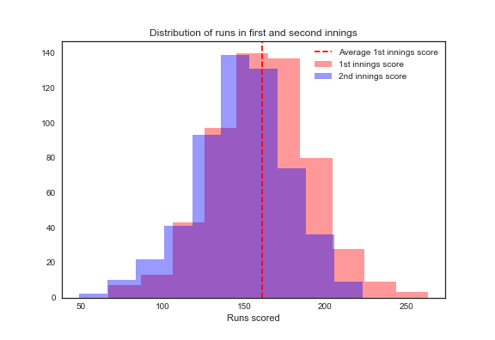

Slide 10
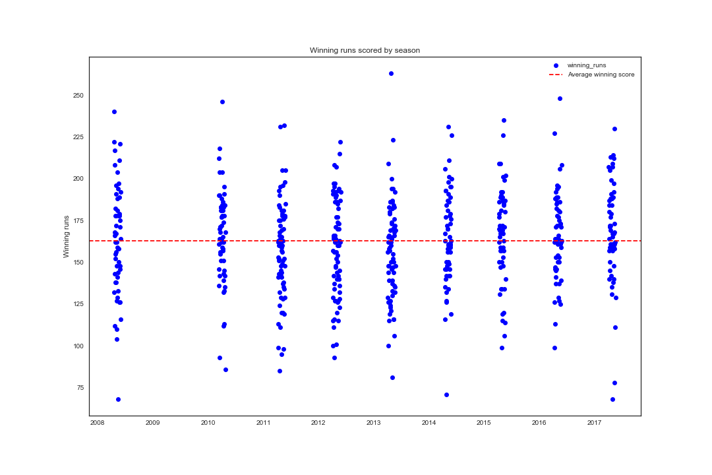

Slide 11
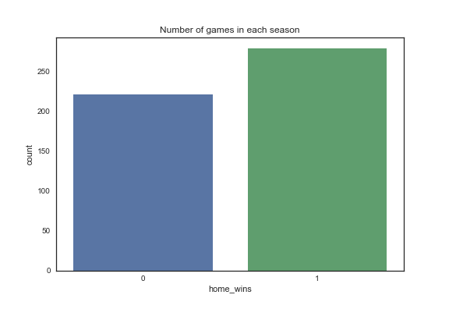

Slide 12
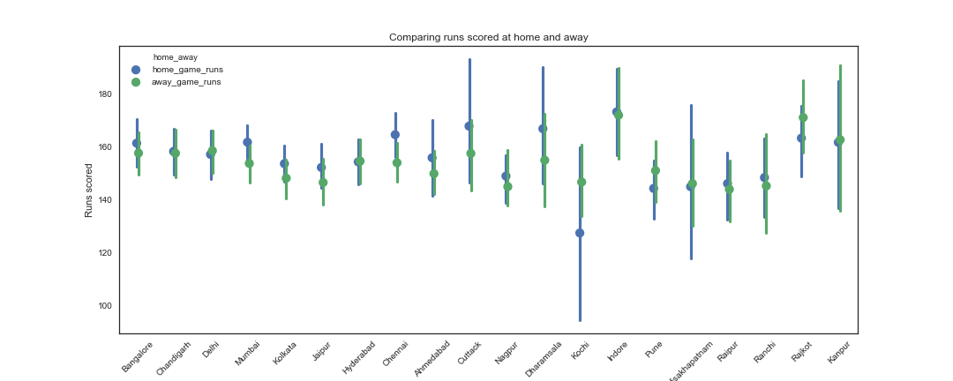

Slide 13
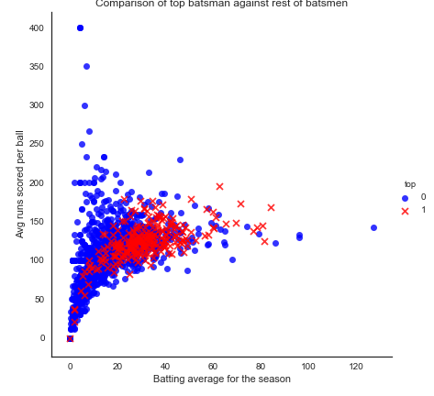

Slide 14
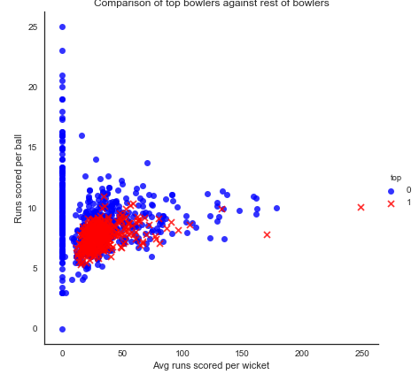

Slide 15
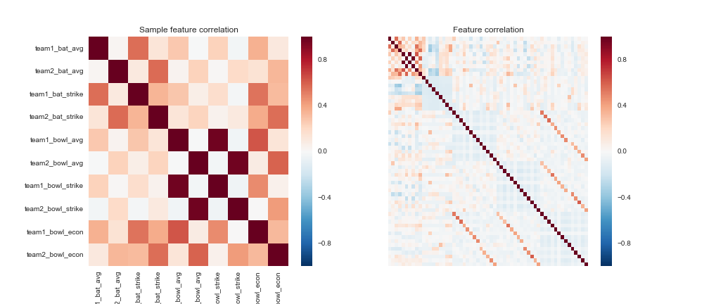

Slide 16
Results
Baseline: Bookies correctly predicted 55.41 per cent of 370 games
 | Accuracy | f1 | min(CV score) | Max(CV score)
Logit | 62.5% | 62.2% | 54.5% | 69.3%
rf | 61.6% | 61.6% | 51.8% | 68.4%
xgc | 61.6% | 60.5% | 50.0% | 61.6%
mlp | 58.9% | 37.1% | 52.7% | 61.6%
seq_nn | 64.3% | 60.2% | 55.0% | 62.5%
Signs of overfitting across all models
Sequential neural network (3 dense layers of 57, 32, 1) performed best

Slide 17
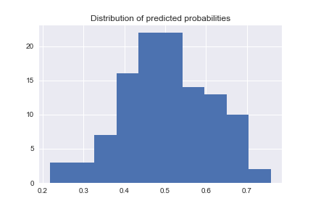
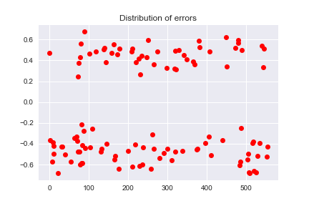
A quick peek under the hood: Logit model
Coefficients:
team1_bat_avg 0.0012
team2_bat_avg -0.0462
team1_bat_strike 0.0285
team2_bat_strike -0.0203
team1_bowl_avg -0.0214
team2_bowl_avg 0.0307
team1_bowl_econ -0.0041
team2_bowl_econ 0.0062

Slide 18
Reducing the feature set
 | Accuracy | f1 | min(CV score) | max(CV score)
logit_pca | 67.9% | 66.8% | 57.4% | 66.3%
rf_pca | 67.9% | 65.7% | 59.5% | 66.4%
xgc_pca | 78.6% | 77.5% | 54.0% | 61.6%
mlp_pca | 64.3% | 61.9% | 48.5% | 61.6%
seq_pca | 62.5% | 62.2% | 54.6% | 57.4%
logit_small | 59.8% | 59.3% | 54.5% | 69.3%
rf_small | 66.1% | 61.7% | 54.5% | 62.1%
PCA on the 8 continuous variables (down to 4)
Manually reducing teams stats to 4 features and dropping seasons
PCA results in significant improvements, random forest model performs well
Sequential neural network (3 dense layers) only model to reduce accuracy (but still relatively stable)

Slide 19
Including betting odds as features
Betting odds can contain valuable and up-to-date information (e.g. weather, injuries, momentum, team dynamics)
But it can also be noisy
Data obtained from oddsportal.com, but missing several games - observations fall to 370
 | Accuracy | f1 | min(CV score) | max(CV score)
Logit_bets | 64.9% | 60.2% | 57.5% | 69.8%
rf_bets | 62.2% | 48.6% | 53.3% | 60.0%
xgc_bets | 59.5% | 57.5% | 53.3% | 63.5%
mlp_bets | 60.4% | 41.5% | 54.8% | 61.3%
seq_nn_bets | 62.2% | 45.2% | 53.4% | 65.3%
Lower observations hurts the model performance
Adding betting odds is the model with the most potential, but needs better odds data (it is possible to buy this)

Slide 20
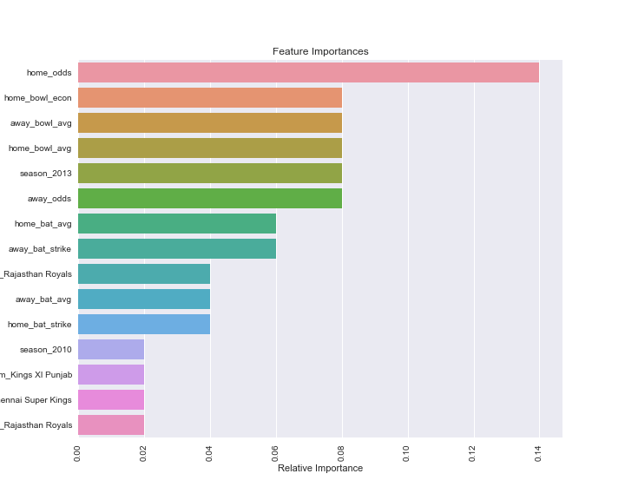

Slide 21
Conclusion
Models are able to outperform prediction based on (simplified) betting odds
But there is a lot more to sports betting, so don’t bet the house just yet
Ways to improve the model:
Overfitting is a concern for many of models (but there are more options for data)
A better data source for the betting odds
Stop the leaks in the team statistics (use previous season’s data or forecast on an entire season)
Tweak feature set-up for team statistics (how many batsmen and bowlers to include)
Combine PCA with betting odds features

Slide 23
